Slide 1

SAFe
(Scaled Agile Framework)

Slide 2
What is SAFe?
An agile framework for software development.
Helps businesses address the significant challenges of developing and delivering enterprise-class software and systems in the shortest sustainable lead time.
It is a freely revealed, online knowledge base of proven success patterns, for
people building the world’s most important software and systems.
It supports smaller-scale solutions employing 50 – 125 practitioners, as well
as complex systems that require thousands of people.

Slide 3

When to Use Scaled Agile Framework?
The presence of the following prerequisites suggests that at the enterprise
you can think about implementing SAFe:
A lot of developed products (the so-called portfolio of projects).
Lots of design roles.
A complex procedure for implementing a proposal or a change
(many reconciliations are required).
A large number of development teams and a desire to work on Scrum.

Slide 4
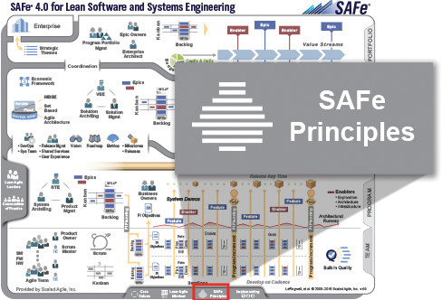
Underlying principles of SAFe
SAFe is based on nine underlying lean and agile principles, that drive the roles and
practices in SAFe:
Take an economic view;
Apply systems thinking;
Assume variability; preserve options;
Build incrementally with fast, integrated learning cycles;
Base milestones on objective evaluation of working systems;
Visualize and limit work-in-progress, reduce batch sizes and manage queue lengths;
Apply cadence (timing), synchronize with cross-domain planning;
Unlock the intrinsic motivation of knowledge workers;
Decentralize decision-making.

Slide 5
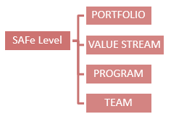
Different levels in SAFe
There are two different types of SAFe implementation:
- SAFe 4.0 implementation (Portfolio, Value Stream, Program, and Team);
- SAFe 3.0 implementation (Portfolio, Program, and Team).

Slide 6
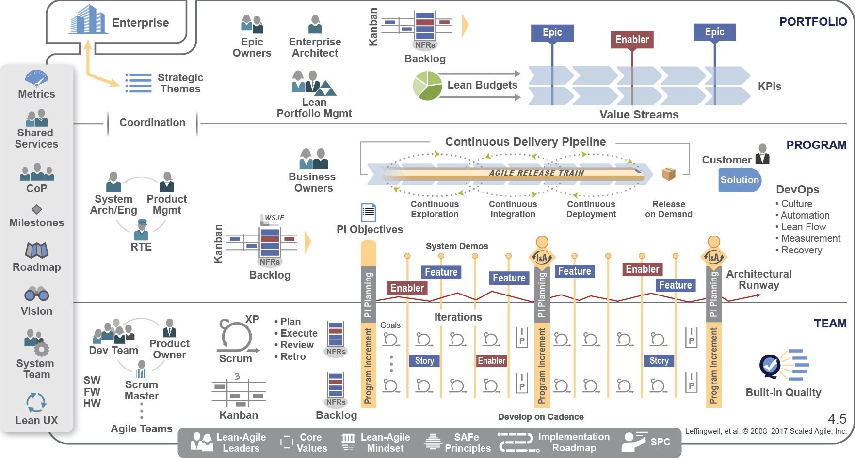
3-level SAFe

Slide 7
SAFe - Team level
Valuable, fully-tested software increments every two weeks;
Empowered, self-organizing, self-managing cross-functional teams;
Teams operate under program vision, architecture and user experience guidance;
Scrum project management and XP-inspired technical practices;
Value delivery via User Stories.

Slide 8
SAFe - Program level
Self-organizing, self-managing team-of-agile-teams;
Working, system increments every two weeks;
Aligned to a common mission via a single backlog;
Common sprint lengths and estimating;
Face-to-face release planning cadence for collaboration, alignment,
synchronization, and assessment;
6. Value Delivery via Features and Benefits.

Slide 9
SAFe - Portfolio level
The portfolio management level of SAFe provides aim for the entire system;
This is where the organization’s strategic themes are given life, value and
priority as part of the development process;
The majority of organizations that can benefit from implementing SAFe either
currently have a Portfolio Management Office (PMO), or have a need to generate
a group that performs this work;
4. SAFe builds upon the typical PMO infrastructure by ensuring Lean and Agile
practices are used.

Slide 10
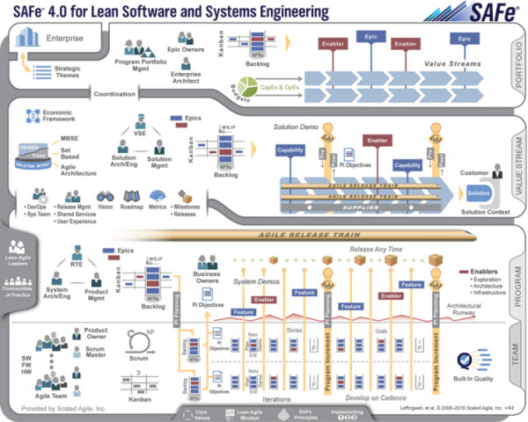
4-level SAFe

Slide 11
Thank you!

